Slide 1


Lending Club Case Study

Slide 2
Background
Lending Club is a confluence of investors looking for structured alternative investments and creditworthy borrowers looking to fulfill their monetary needs. There is a large part of the Indian population not covered by traditional credit-providing institutions. Simultaneously, there is an investor class looking to diversify their portfolio with alternative investment options that yield high returns.
Lending Clubfill this gap and bring these demographics together, creating an ecosystem for people to meet their financial goals. We, as market leaders, strive to fulfill the demands that have been left unattended by others and are the fastest growing P2P lending platform in the country. We are led by passionate problem solvers and backed by investors around the world to realise this dream and become the most trustworthy platform for both our investors and borrowers.

Slide 3
Objective
In this case study, you will use EDA to understand how consumer attributes and loan attributes influence the tendency of default. When a person applies for a loan, there are two types of decisions that could be taken by the company: Loan accepted: If the company approves the loan, there are 3 possible scenarios described below:
Fully paid: Applicant has fully paid the loan (the principal and the interest rate)
Current: Applicant is in the process of paying the instalments, i.e. the tenure of the loan is not yet completed. These candidates are not labelled as 'defaulted’.
Charged-off: Applicant has not paid the instalments in due time for a long period of time, i.e. he/she has defaulted on the loan
Loan rejected: The company had rejected the loan (because the candidate does not meet their requirements etc.). Since the loan was rejected, there is no transactional history of those applicants with the company and so this data is not available with the company (and thus in this dataset)

Slide 4
Objective
The analysis is divided into four main parts:
Data understanding
Data cleaning
Data Analysis
Conclusion

Slide 5
Data Understanding
Types of variables
Customer (applicant) demographic
Loan related information & characteristics
Customer behavior (if the loan is granted)
E.g.
Customer demographics | Loan Information | Customer Behavior
Employment Length | Loan Amount | Delinquency Year
Employment Title | Funded Amount | Revolving Balance
Annual Income | Interest Rate | Recoveries
Description | Loan Status | Application Type

Slide 6
Data Cleaning
Please refer to python file for cleaning and hypothesis

Slide 7
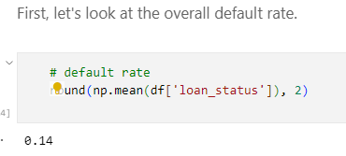
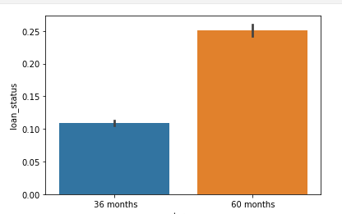
Data Understanding
1. Overall Default Rate is 14%

Slide 8
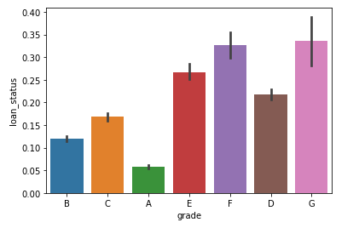
Data Analysis
1. Verification Status vs Loan Status
Clearly, as the grade of loan goes from A to G, the default rate increases. This is expected because the grade is decided by Lending Club based on the riskiness of the loan.

Slide 9
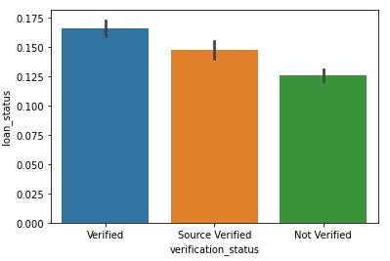
Data Analysis
2. Verification Status vs Loan Status
Contradiction to the expected values the verified loans default more than not verified

Slide 10
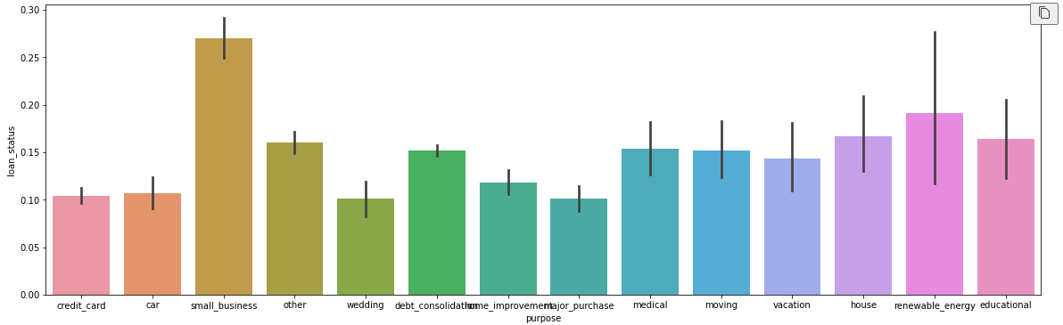
Data Analysis
3. Purpose vs Loan Status
Small business loans default the most, then renewable energy and education

Slide 11
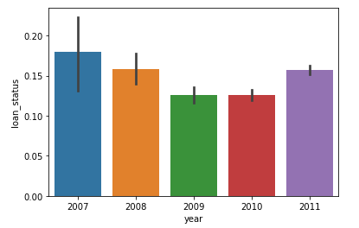
Data Analysis
4. Year vs Loan Status
The rate had suddenly increased in 2011

Slide 12
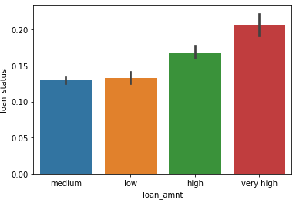
Data Analysis
5. rates across loan amount type
Binning the loan amount to ease analysis

Slide 13
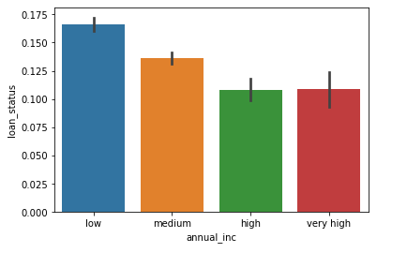
Data Analysis
6. Annual income and default rate
Lower the annual income, higher the default rate

Slide 14
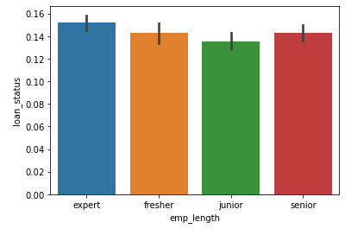
Data Analysis
7. Employment Length and default rate

Slide 15
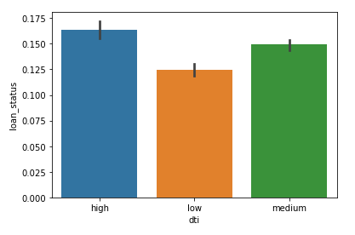
Data Analysis
8. default rates across debt to income ratio
High dti translates into higher default rates, as expected

Slide 16
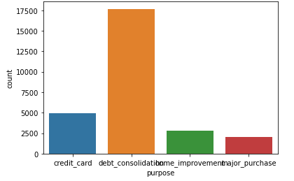
Data Analysis
Analyze the top 4 types of loans based on purpose:
consolidation
credit card
home improvement
major purchase.

Slide 17
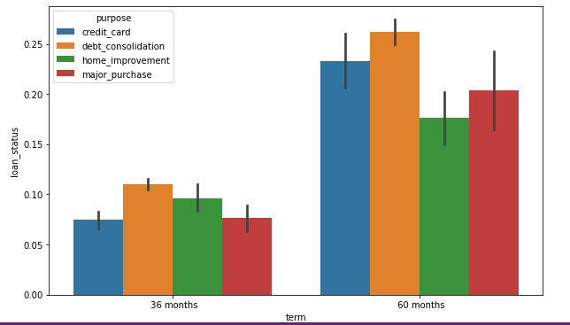
Data Analysis
default rates across two types of categorical variables purpose of loan (constant) and another categorical variable (which changes)

Slide 18
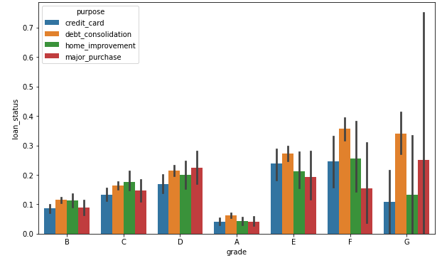
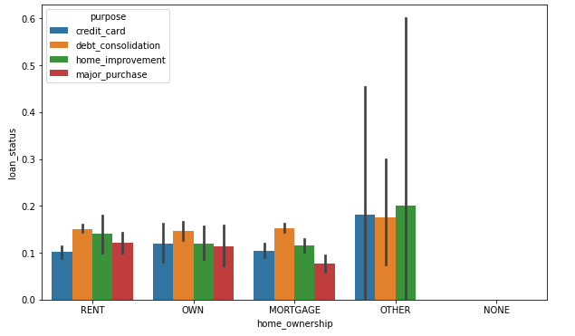
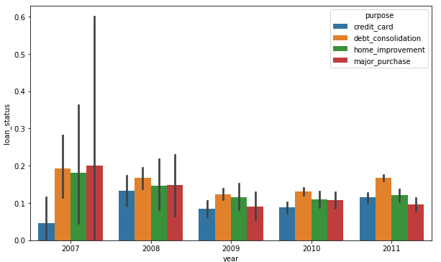
Data Analysis
Default rates across two types of categorical variables
Purpose / Term / status
Grade / purpose / status
Home ownership / Status / purpose
Year / purpose / status

Slide 19
Conclusion
The grade of loan goes from A to G, the default rate increases
Contradiction to the expected values the verified loans default more than not verified
Small business loans default the most, then renewable energy and education
Lower the annual income, higher the default rate
High dti translates into higher default rates, as expected

